Slide 1
Human Activity Recognition from Accelerometer Data
Anthimos Kalosidis
Garo Garabetian
Department of Mathematics, AUTh

Slide 2
Workflow Outline
Data pre-processing
Feature Extraction
Model Construction / Evaluation
Model Comparison / Selection
Testing on Independent Data / Activity Grouping
Testing on Different Position
Conclusions

Slide 3
Raw Data & Structure
Selected “Left Pocket” as our data set
Ten (10) participants, each doing seven (7) activities
About 3-4 minutes per activity
Sampling rate: 50 samples / second (Hz)
Notes:
Brief outline of the raw data. Bridge: Now we shall proceed by showcasing how we handled the given data (preprocessing) να αποφευχθούν συνεχώς οι ίδιες λέξεις, ΟΧΙ όμως όταν πρόκειται για ορολογία

Slide 4
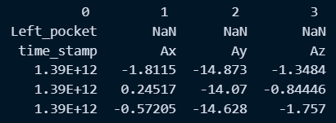

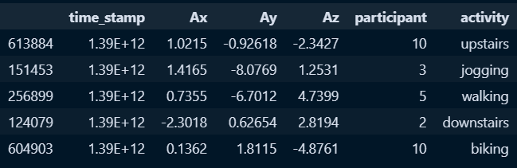
Data Preprocessing
Extract only essential columns (Ax, Ay, Az, activity, participant)
Combine all participants and compute acceleration magnitude

Slide 5
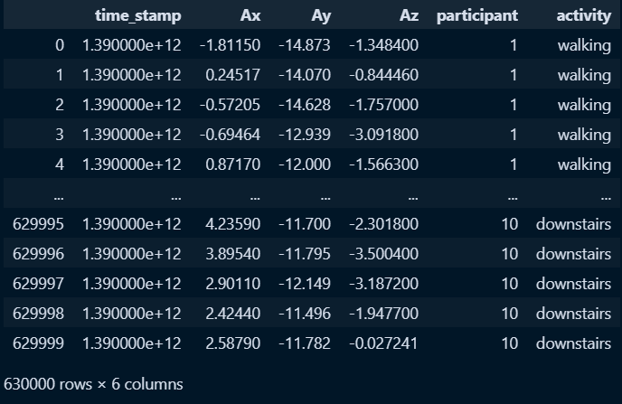
Data Cleanup
Handle possible outliers in data
None found (!)
Check for missing values
Data shape:

Slide 6
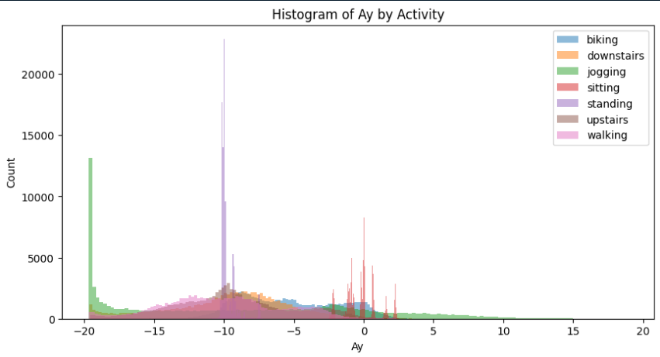
Data Exploration
Different axes highlight different activities (check Biking here)
Notes:
Present a histogram (i chose Ay because it is clear to see biking for example). Note the patterns that are already arising (check Ay ~= 10 m/sec^2 for biking activity , or Ay hovering around 0 for sitting). Also histograms for Ax, Az, in which we can also observe similar patterns. (we elect to not show everything so as not to repeat ourselves)

Slide 7
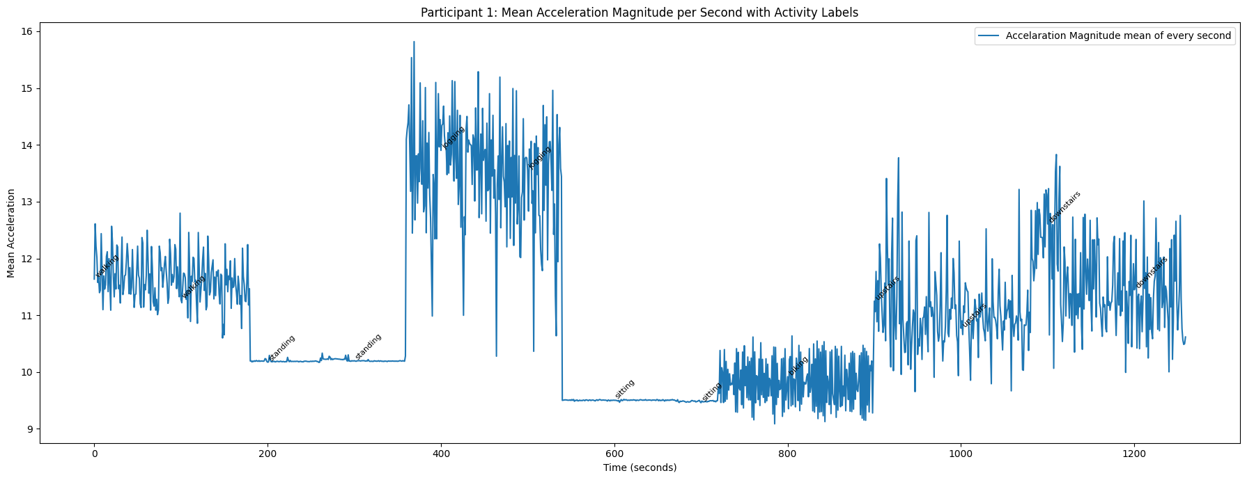
Signal Visualization
Trend plot for participant 1
Notes:
Explain each peak and low (keep in mind that labels might not be visible to the viewer, so explain what we’re seeing here). Finally, bridge this final preprocessing slide to the next (first feature_extraction slide)

Slide 8
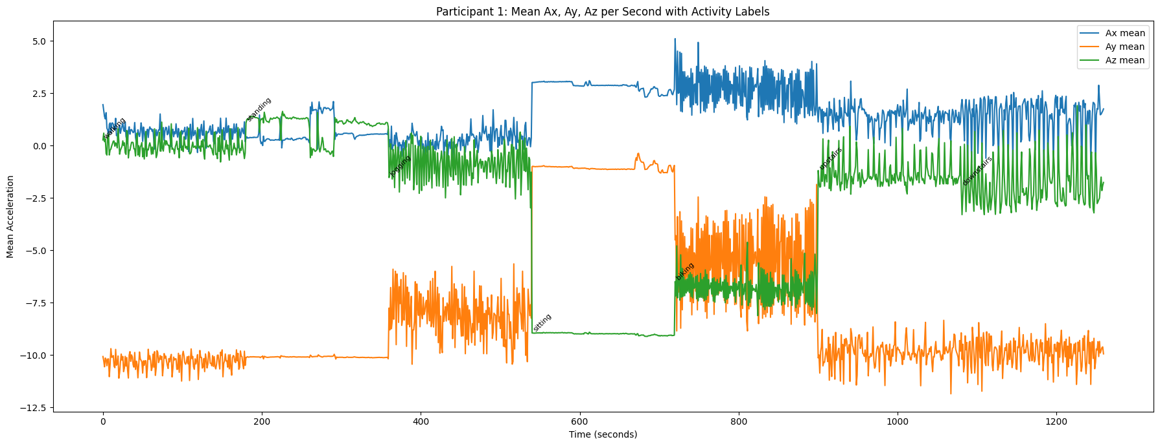
Creating Sliding Window
Window size: 20 sec (1000 samples)
Highly overlapping
Sliding every 1 second (50 samples)
Label each window with the majority activity
Statistical Features per window:
Mean value
Standard Deviation
Skewness
Max Value
Min Value
Range (Max - Min)

Slide 9
Creating Sliding Window
Window size: 20 sec (1000 samples)
Highly overlapping
Sliding every 1 second (50 samples)
Label each window with the majority activity
Statistical Features per window:
Mean value
Standard Deviation
Skewness
Max Value
Min Value
Range (Max - Min)

Slide 10
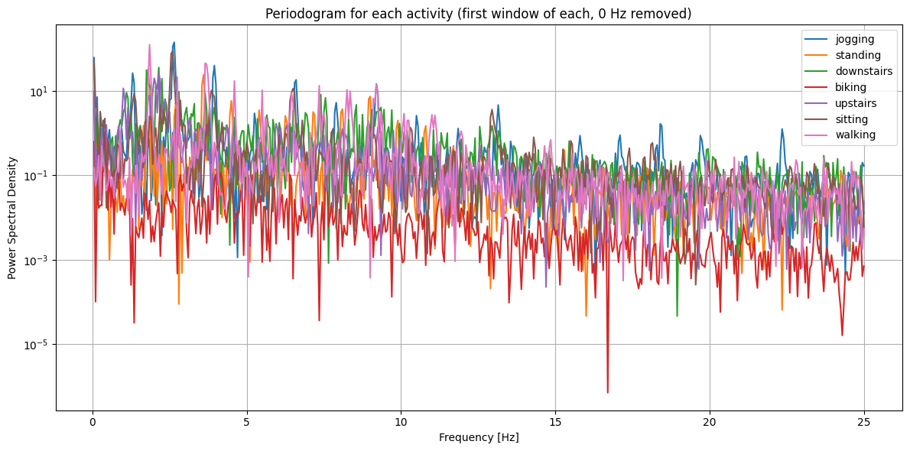
Periodogram
Activities have distinctive spectral “fingerprints”

Slide 11
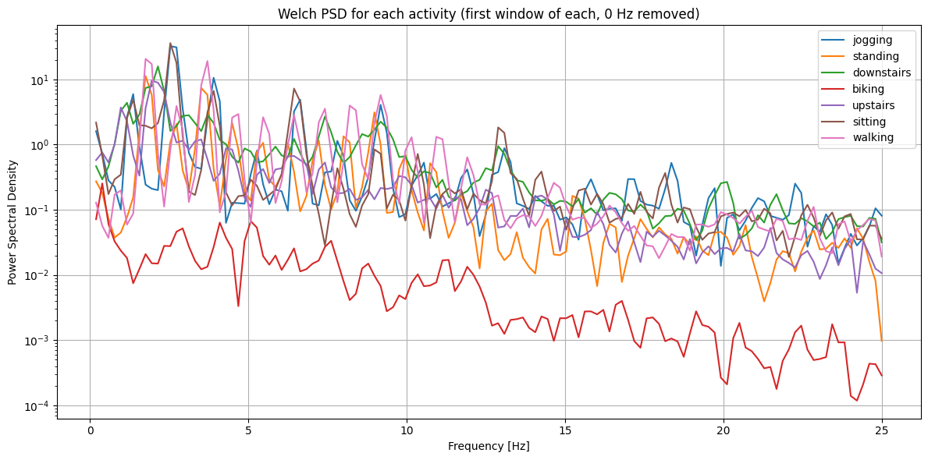
Selected Features Extracted:
Spectral Centroid
Spectral maximum
Spectral Bandwidth
Notes:
Again, bridge to LOSO modeling (using these features we move on to cross-validation steps ….)

Slide 12

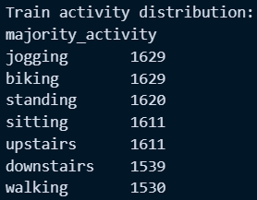
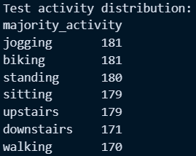
LOSO cross-validation
Train on N-1 subjects, test on the remaining
Assess generalization to unseen people / pockets

Slide 13
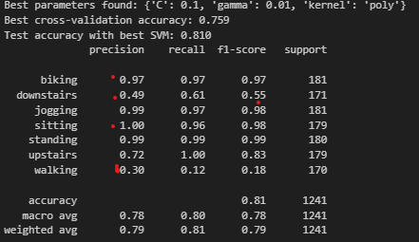
Support Vector Machine (SVM) Results
Mean LOSO SVM Accuracy: ~0.73
Optimal Hyperparameters:
Kernel: Poly Degree:2
C = 0.1
γ = 0.01
Employed Grid Search with 3-fold cross-validation for faster results
For the final model, LOSO was implemented

Slide 14
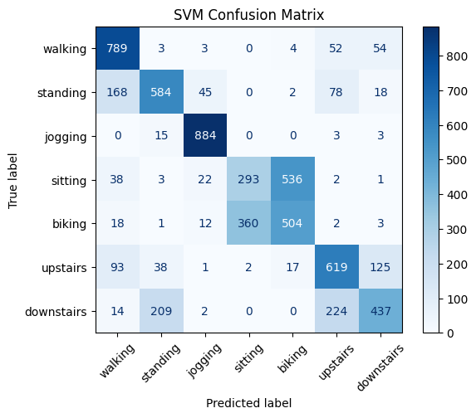
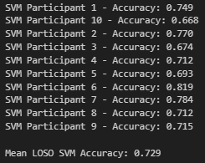
Support Vector Machine (SVM) Results
Standing
Upstairs
Downstairs
are more often confused

Slide 15
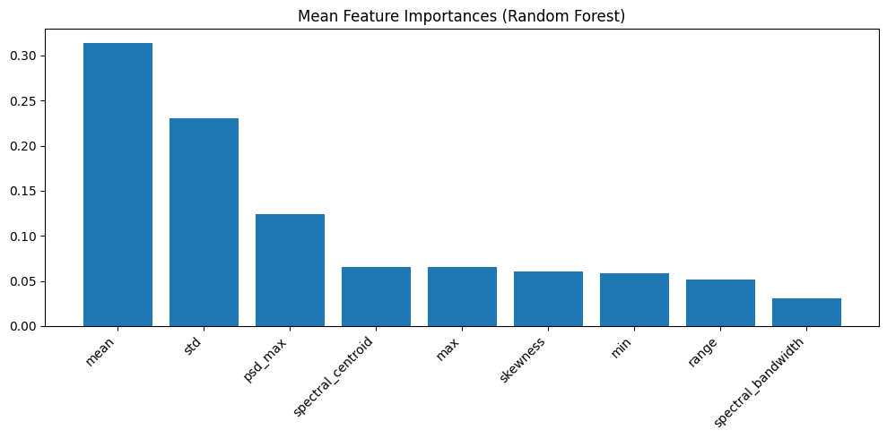
Random Forest Classifier Results
Mean LOSO RF Accuracy: ~0.78
No significant optimization achieved with hyperparameter tuning

Slide 16
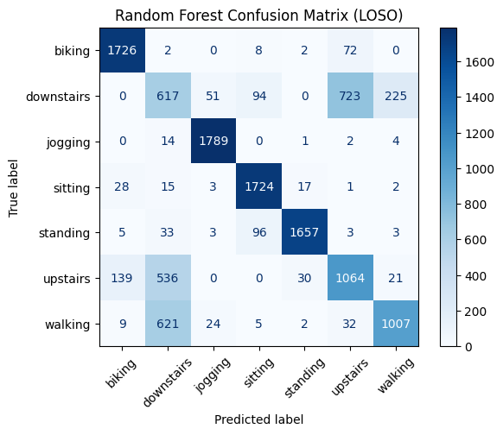
Random Forest Classifier Results
Upstairs - Downstairs
consistently confused
Note: Walking

Slide 17
MLP (Neural Network) Results
Very poor results without parameter optimization (2 hidden layers, momentum = 0.9)
Optimal Hyperparameters:
Activation function: tanh
Regularization term (alpha) = 0.001
2 hidden layers, 20 neurons & 10 neurons
Momentum = 0.95
Weight Opt Solver = Stochastic Gradient Descent (SGD)
Number of Epochs = 500
Best LOSO Test Accuracy: ~0.77

Slide 18
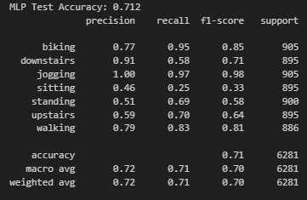
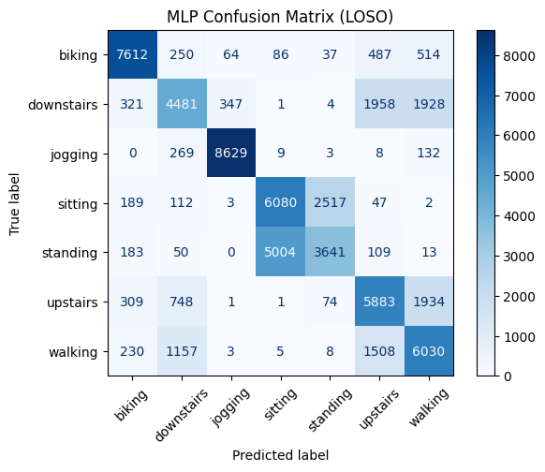
MLP (Neural Network) Results

Slide 19
Raw Data and Structure
Selected “Left Pocket” as our data set
Extract selected data for each participant

Slide 20
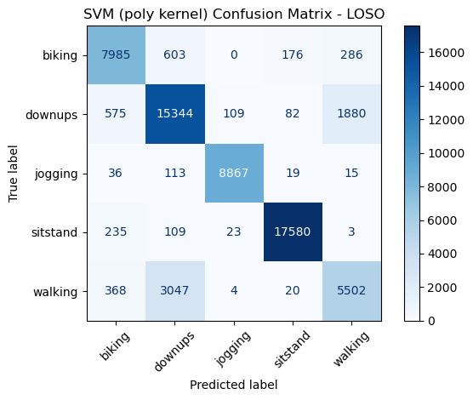
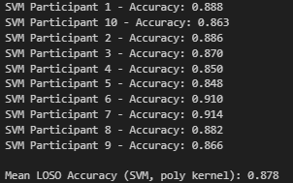
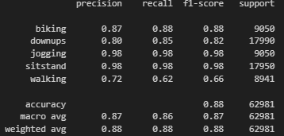
Combining Labels
Sitting – Standing
Upstairs - Downstairs
Increased Accuracy after retraining the optimal models

Slide 21
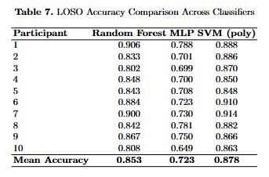
Combining Labels
Sitting – Standing
Upstairs - Downstairs
Increased Accuracy after retraining the optimal models
SVM polynomial kernel degree 2

Slide 22
Combining Labels
Sitting – Standing
Upstairs - Downstairs
Increased Accuracy after retraining the optimal models
SVM polynomial kernel
degree 2

Slide 23
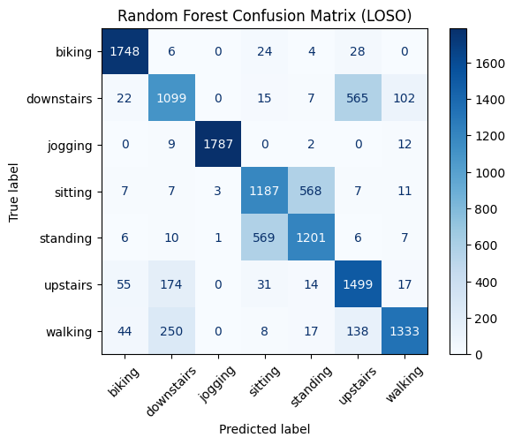
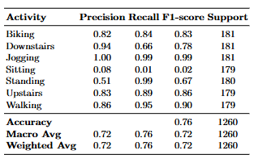
Comparing with other position of the sensor
Train on Left Pocket (LOSO)
Use of optimal Random Forest and SVM
Test on Right Pocket
Optimal Random Forest Classifier
Mean LOSO Accuracy: 78.2%

Slide 24
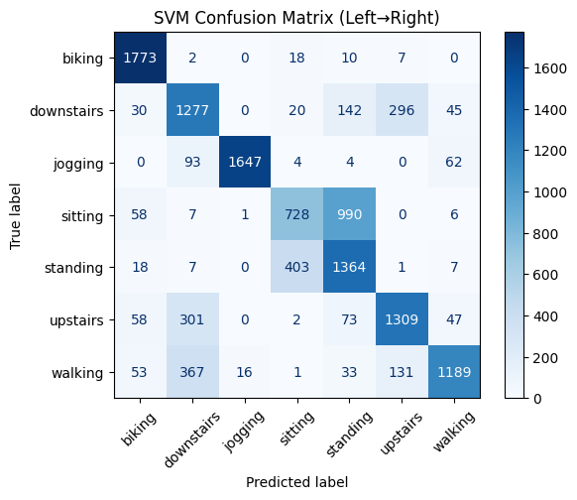
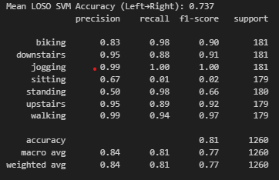
Comparing with other position of the sensor
Train on Left Pocket (LOSO)
Use of optimal Random Forest and SVM
Test on Right Pocket
Optimal SVM Performance
Mean LOSO Accuracy: 73.7%

Slide 25
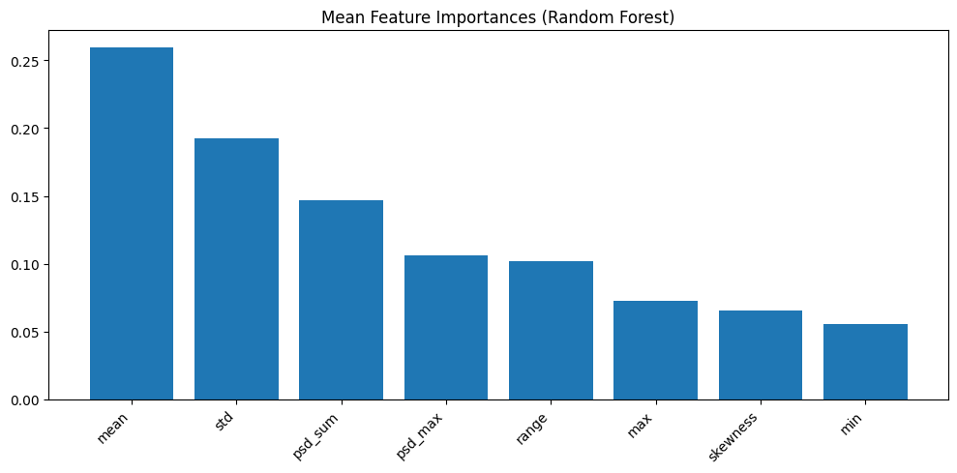
Further Optimization and Recomendations
Advanced Features: Consider wavelet transforms, autocorrelation, ARIMAmodels for fit and raw time-series modeling with deep learning (LSTM)
Consideration on Time Windows: Experiment with different window sizes and overlaps to optimize feature extraction.
Confidence Intervals: Use prediction intervals to quantify uncertainty in classifications.
Ensemble Models: Combining RF, SVM, and tuned MLP could yield amore robust “majority voting” classifier.
Multi-sensor Fusion: Including gyroscope, magnetometer improves power.
Sensor Calibration: If feasible, leverage calibration routines to adjust for individual posture.

Slide 26
References:
Hastie, Trevor, Tibshirani, Robert and Friedman, Jerome. The Elements of Statistical Learning. New York, NY, USA: Springer New York Inc., 2001.
S. Guido and A. C. Mueller, Introduction to Machine Learning with Python, Sebastopol, CA: O'Reilly Media, 2016.
Yuan, Xiaoguang, Shiruo Liu, Wei Feng, and Gabriel Dauphin. 2023. "Feature Importance Ranking of Random Forest-Based End-to-End Learning Algorithm" Remote Sensing 15, no. 21: 5203. https://doi.org/10.3390/rs15215203

Slide 27
References:
Hastie, Trevor, Tibshirani, Robert and Friedman, Jerome. The Elements of Statistical Learning. New York, NY, USA: Springer New York Inc., 2001.
S. Guido and A. C. Mueller, Introduction to Machine Learning with Python, Sebastopol, CA: O'Reilly Media, 2016.
Yuan, Xiaoguang, Shiruo Liu, Wei Feng, and Gabriel Dauphin. 2023. "Feature Importance Ranking of Random Forest-Based End-to-End Learning Algorithm" Remote Sensing 15, no. 21: 5203. https://doi.org/10.3390/rs15215203
Thank you for your attention!
Any questions?

